Slide 1
TIP : Speech2Face
Learning the face behind a voice

Slide 2
Introduction
When we listen to a person speaking without seeing his/her face, on the phone, or on the radio, we often build a mental model for the way the person looks.
There is a strong connection between speech and appearance, part of which is a direct result of the mechanics of speech production: age, gender (which affects the pitch of our voice), the shape of the mouth, facial bone structure, thin or full lips—all can affect the sound we generate.
In addition, other voice-appearance correlations stem from the way in which we talk: language, accent, speed, pronunciations—such properties of speech are often shared among nationalities and cultures, which can in turn translate to common physical features.

Slide 3
Aim :
To study to what extent we can infer how a person looks from the way they talk.
From a short input audio segment of a person speaking, our method directly reconstructs an image of the person’s face in a canonical form
Since there can’t be a one to one matching between voices and faces , our goal is not to predict a recognizable image of the exact face, but rather to capture dominant facial traits of the person that are correlated with the input speech.

Slide 4
Methodology :
We design a neural network model that takes the complex spectrogram of a short speech segment as input and predicts a feature vector representing the face.
More specifically, face information is represented by a 4096-D feature that is extracted from the penultimate layer (i.e., one layer prior to the classification layer) of a pre-trained face recognition network
We decode the predicted face feature into a canonical image of the person’s face using a separately trained reconstruction model.
To train our model, we use the AVSpeech dataset [14], comprised of millions of video segments from YouTube with more than 100,000 different people speaking.

Slide 5
Pipeline :
The Speech2Face pipeline, will consist of two main components:
1) a voice encoder, which takes a complex spectrogram of speech as input, and predicts a low-dimensional face feature that would correspond to the associated face; and
2) a face decoder, which takes as input the face feature and produces an image of the face in a canonical form (frontal-facing and with neutral expression).
During training, the face decoder is fixed, and we train only the voice encoder that predicts the face feature. The voice encoder is a model we designed and trained, while we used a face decoder model proposed by in a paper by Cole et al.

Slide 6
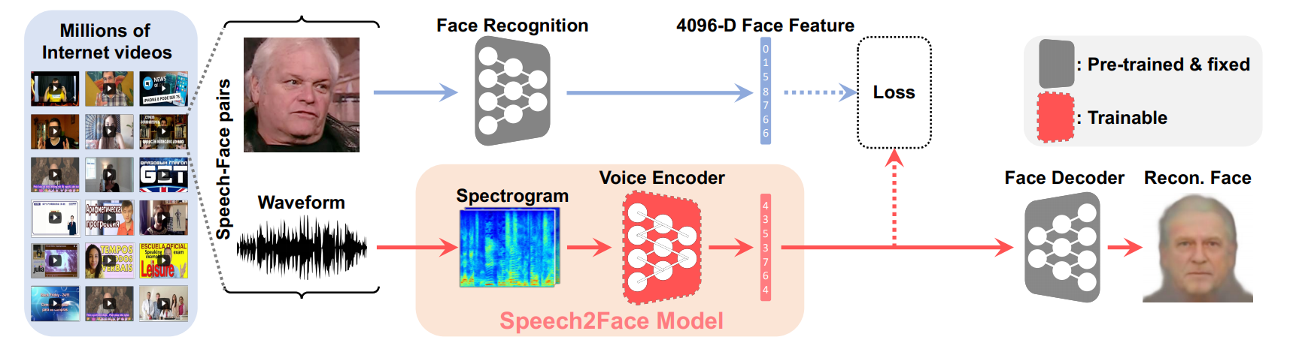
Illustration of pipeline :

Slide 7
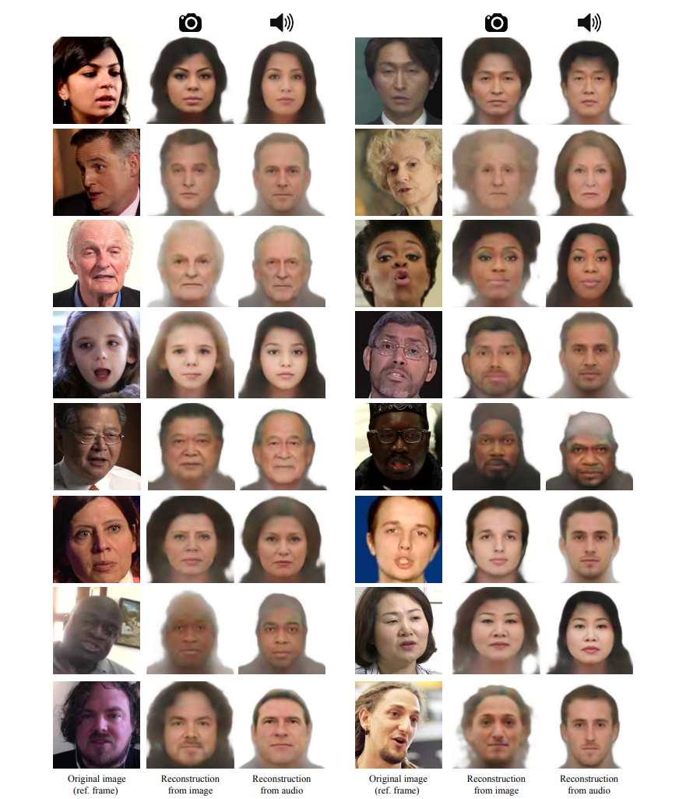
Example :

Slide 8
References :
Speech2Face: Learning the Face Behind a Voice -https://arxiv.org/pdf/1905.09773.pdf
F. Cole, D. Belanger, D. Krishnan, A. Sarna, I. Mosseri, and W. T. Freeman. Synthesizing normalized faces from facial identity features. In IEEE Conference on Computer Vision and Pattern Recognition (CVPR), 2017.

